Slide 1
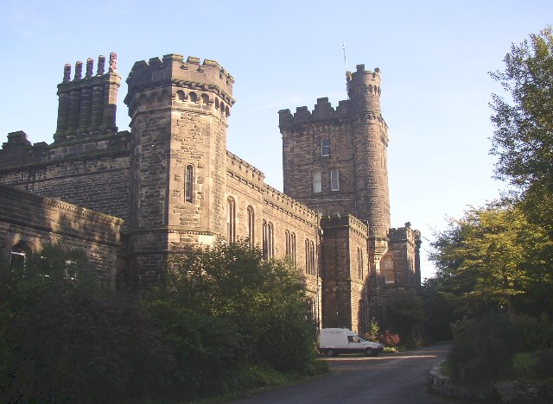
Dobroyd Castle
(Todmorden, Lancashire)
Friday 8th March - Sunday 10th March
2024

Slide 2
Staff
Miss Gray (Trip leader)
Mr Doolan (HOY)
Mr Aoun
Miss Noon
Mrs Gallagher
Miss Byrom
64 x Year 7 pupils

Slide 3
Behaviour
All pupils behaviour leading up to this trip is monitored and students will be removed from the trip if we feel they are not adhering to our expectations as a school.
If poor behaviour is displayed during the trip from any student then we will ask parents to come and collect their child from Dobroyd Castle.

Slide 4
Travel
Friday 8th March –
leaving school at 9:40am
(pupils must arrive to school by 8:50am and meet in the gym)
Sunday 10th March –
arriving back at St. Bede’s at 3:30pm – 3:45pm approx.
PLEASE DO NOT PARK ON THE YELLOW ZIG ZAGS OUTSIDE SCHOOL

Slide 5
Friday 8th March
Pupils to arrive at 8:50am and go to the GYM.
9:40am approx – depart St. Bede’s
Please wear clothes that are suitable for activities when you arrive to school.
All pupils will be given their lunch at Robinwood so you will not need to provide a packed lunch.

Slide 6
Meals
Dobroyd Castle is able to cater for any special dietary requirements.

Slide 7
Contact information
Please make a note of the mobile contact number:
07307 524891
Only use this number in emergencies
Centre number :
01706 814554

Slide 8
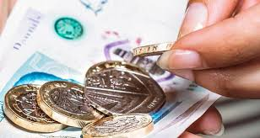
Money
Souvenirs can be purchased at the centre.
There won’t be a tuck shop this year. Pupils can bring their own sweets on the trip but not too many!
Please do not bring any sweets/snacks that contain nuts.

Slide 9
Souvenirs
Here a few examples of the souvenirs available to purchase:

Slide 10
Activities
Archery
Canoeing
Climbing
Crate Challenge
Giant Swing
Caving
Zip Wire
Dungeon
Trapeze
(see additional info)

Slide 11
What to bring
3 T Shirts
3 Sweatshirts/long sleeved top
3 Trousers
1 Shorts
Underwear
Socks
Indoor shoes (1pair)
Outdoor shoes (1pair)
2 Towels
1 Coat – waterproof
1 Warm hat
1 Pair of gloves
Bin Bag
Nightwear
Toiletries – no aerosol sprays!!
Water bottle
PLEASE TRY AND HAVE YOUR CHILDS NAME ON CLOTHING/ITEMS

Slide 12
Clothing
Robinwood provides a selection of additional clothing:
Waterproof cagouls
Warm tops
Wellies
Footwear for watersport activites

Slide 13
Medication
Any medication that your child will require must be given to Miss Gray before we leave.
It must be clearly labelled with the pupils name and the dosage etc. Please could you also make sure that we have written permission from yourselves to allow us to give your child the medicine.
If your child has an inhaler they must make sure they are carrying it with them at ALL times. It is advised to pass a spare inhaler to Miss Gray.

Slide 14
A typical day
7:00am - 8:00am Wake up
8:00am - 8:30am Breakfast
9:00am -12:30pm 3 Activity Sessions
12:30pm - 1:00pm Lunch
1:00pm - 5:00pm 3 Activity Sessions
5:00pm - 6:00pm Evening Meal
6:00pm - 9:00pm 2 Activity Sessions
9:00pm - 9:30pm Hot Chocolate & review
9:30pm - 10:30pm Sleep!!

Slide 15
Bedrooms
Once we have been allocated room numbers by Robinwood there will be a meeting for pupils to attend.
This tends to be held a few days before departure.

Slide 16
Additional information
No mobile phones, I-pads or handheld computer games are allowed on this trip.
The pupils will not have time to go on these as there is a very busy schedule, and their full concentration will be needed at all times.

Slide 17
Robinwood camera policy
School policies on photographing children vary, and most schools have children whom no permission to photograph has been granted.

Slide 18
Robinwood 2024 Facebook page to keep you updated on the weekend. (A link will be sent to you prior to the trip).
If you do not want your child on our Facebook/Instagram page please let me know.
@stbedesormskirkpe

Slide 19
You should have received….
Personal Information Form
Attachments to email: Parents booklet
Menu
Clothing list
Code of conduct

Slide 20
What I need from you
From your pack I will need:
Information form returned to school by Monday 5th February 2024
Pass onto form teacher or Miss Gray

Slide 21
Website
http://www.robinwood.co.uk
If you have any further queries/questions, then please contact me via email – g.gray@sbchs.co.uk

