Slide 1
ROAR Programme
Year 7 - Class of 2022-23
Mr Holt,
Miss Caldwell,
St John Rigby Sixth Form College

Slide 2
Why join this programme?
Challenge.
Thoughtful
Independent
Glimpse of the future
Learn from experts
Fun with friends
Make a difference
Understand the world better
Explore in depth
Choice
Having a voice

Slide 3
What does ROAR stand for?
ROAR stands for 'Russell Group or Alternative Ready'.
There are 24 Russell Group Universities. Some examples of these are;
University of Liverpool
University of Glasgow
University of Cambridge
University of Oxford
University of York
RED BRICK Universities
.

Slide 4
Why go to university?
There are jobs where a degree is essential e.g. Doctor, Dentist, Vet
Students may enjoy particular subjects and want to continue to study it further
To take advantages of all the different opportunities at university
To improve job prospects – 40% of graduate jobs don’t require a specific degree, they just need you to have one!

Slide 5
So what is the ROAR programme?
The ROAR programme will look to raise your aspirations through a course of challenge, inspiring speakers and project based learning.
WHAT SKILLS WILL THE PROGRAMME DEVELOP?
Written English
Essay writing skills
Note taking skills
Independent learning
Research
Presentation skills
Debating skills
Critical and Creative thinking skills
Confidence/ motivation
Interpersonal skills – new friends?
Time management skills

Slide 6
Date | Topic
Tuesday 6.00pm 21 02 2023 | Virtual Parent’s Evening
Tuesday 28 02 2023 3.30-4.30 pm | Posing the Question P4C / Community of Enquiry
Tuesday 07 03 2023 3.30-4.30 pm | Introduction – Debating Skills
Tuesday 14 03 2023 3.30-4.30 pm | Critical Thinking 1
Tuesday 21 03 2023 3.30-4.30 pm | Presentation Skills
Tuesday 28 03 2023 3.30-4.30 pm | Critical Thinking 2
Tuesday 18 04 2023 3.30-4.30 pm | Dialogue enquiry
Tuesday 25 04 2023 3.30-4.30 pm | Research skills
Tuesday 2 05 2023 3.30-4.30 pm | Essay writing, referencing and plagiarism
Tuesday 09 05 2023 3.30-4.30 pm | Essay write up and preparation session
The programme

Slide 7
Tuesday 15 05 2023 Assignment Submission date at 3.30pm
Tuesday 23 05 6.00 pm 2023 Exhibition Evening

Slide 8
The project
Enquiry Question to form the discussion.
What will you do?
1. You will write a 1000 word essay to answer the question.
2. The exhibition will give you the chance to present your new knowledge and skills in any way that you choose.
Notes:
The ROAR Programme aims to give Year 10 pupils a flavour of university life both socially and academically.
Pupils will be challenged to work towards answering the following question, . Discuss.
Pupils will be required to answer this question in 1000 words in the format of an essay/assignment.
Pupils will also be required to prepare a three minute presentation about their essay/assignment in preparation without powerpoint for the Graduation and Exhibition evening.
Do not worry pupils and parents…. We have sessions which will help your along your ROAR Programme journey!

Slide 12
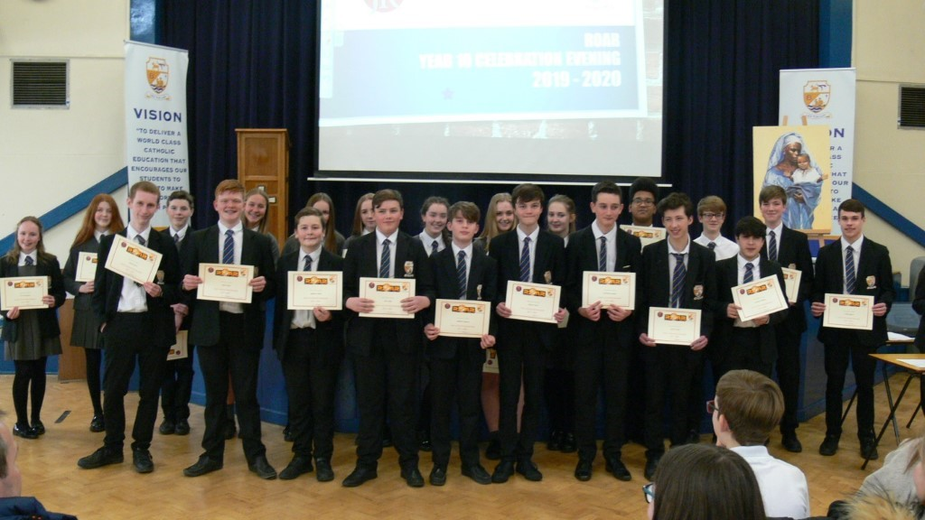
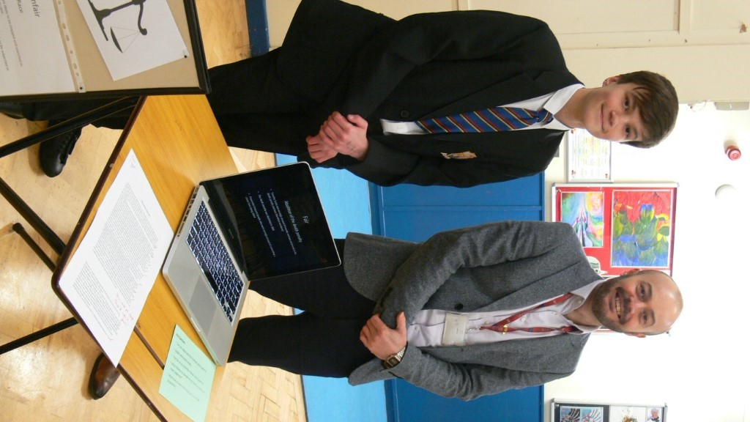
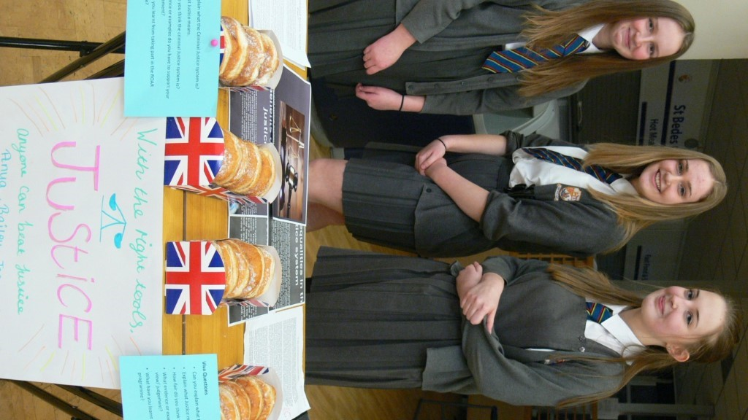
In the roar programme I have learnt about how to present your ideas. I have learnt how to talk in front of people confidently and not read off my presentation. I have also gained many research skills.
Tom
During ROAR I have learnt about how the justice system although seemingly fair and equal can actually cause more suffering than closure. My research skills have improved drastically and my debate skills have directly been affected due to this as I now know how and when to cite sources I have referred to. This programme has also given me an insight on what I am to expect during higher education.
Joanna

Slide 13
