Slide 1
Mr Holt Assistant Headteacher
Study Skills

Slide 2
Study Skills for Year 11
Memory skills
Mind mapping
Summarising notes
Analogy
Evaluation (diamond nines)
Active learning
Health/ Fitness/ Diet
Time management and Planning
Motivation/ Mindfullness
Environment

Slide 3
Planning
Processing
Practise
Perseverance
P ????

Slide 6
1. Memory

Slide 7
Long Term and Short Term Memory

Slide 8
Revision Segments 20 /5/20/ 5

Slide 9
1. Memory
Retrieval Practice
Please see the link to the Leitner method below.
https://www.youtube.com/watch?v=d9u3KxGCio8
A Year 11 pupil Laurence Kidd came up with a further adaptation which is to create a question on the other side to which the information is the answer to.

Slide 10
For Further exploration
Please also find attached a podcast from the Learning Scientists on Retrieval Practice.
https://www.learningscientists.org/learning-scientists-podcast/2017/9/20/episode-3-bite-size-research-on-retrieval-practice-formats

Slide 11
Flash Card principles
Make them clear and simple
Make then your own
Write a question that the flash card is the answer to
Include an image or a picture to help you remember.
I flash card per question

Slide 12
How to study successfully with FlashCards?
https://www.youtube.com/watch?v=mzCEJVtED0U&t=4s

Slide 13
Retrieval Practice techniques that improve memory
Flash Cards
Leitner Method
Quizzes and tests
Writing what you know from memory on a Blank sheet
Writing what you know on a Mind Map / Concept Map

Slide 14
Other memory techniques
Mnemonics
Visualisation
The theory of Loci method
Number system
Rhythm and Rhyme
Blocks of five
Visual film strips
Dual coding
Elaboration

Slide 15
The seven keys Use these keys to memorise
Outstanding
Funny
Personal
Emotional
Linked to our senses
Connected with sexuality
First and last thing

Slide 16
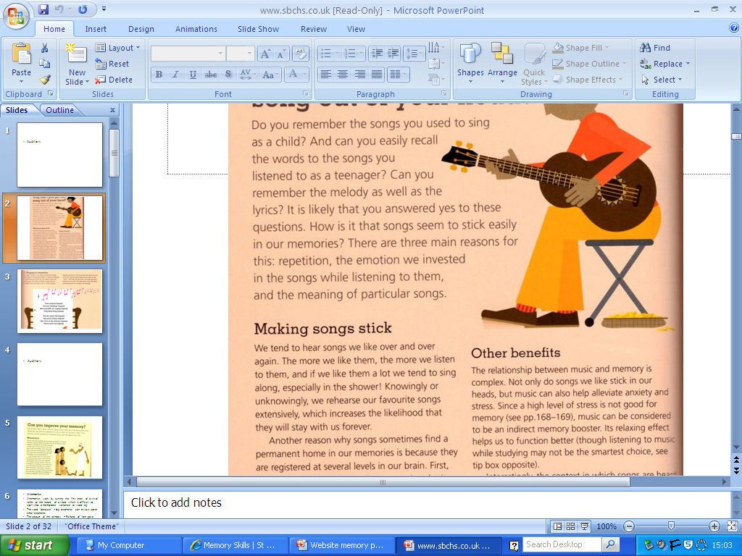
Memory techniques and learning styles
Visual, Auditory and Kinaesthetic
Peg system
Mind Maps
Visual, Kinaesthetic
Journey method and loci
Reports
Use of body parts
Blocks of five
Auditory
Song and rhythm
Mnemonics
Visual
Visualisation
Link with visual images
Oversize or Undersize
Kinaesthetic
Use your body
Blocks of five
Visual and Kinaesthetic
Journey method – theory of loci
Reports, films and journeys
Use your body
Blocks of five

Slide 17
2. Mind Mapping
Mind Mapping is the process of visually depicting a central concept with symbols, images, colours, key words, and branches. Mind mapping is a fast and fun way to take visual notes, foster creativity, stretch pupils’ visual thinking skills, make learning contextual and meaningful, and promote active involvement with the learning content.
Steps
1. Create the central image
In the centre of the page, write the name of and illustrate the central concept with a recognisable image. Make the central image large enough so you can see the subject of the mind map at a glance, but small enough to leave space to add main ideas and details radiating out of the central image. Make the central image colourful and vivid, but make it a quick and identifiable symbol rather than a beautifully illustrated picture.
2. Brainstorm main ideas
Draw lines radiating out of the main image, with a key word on each line describing the main idea.
3. Add details
Using colours, images, symbols and words, draw related details branching out of each of the main ideas.

Slide 20
3. Summarising Notes
An approach- five steps for summarising
Delete unwanted extra (trivial) details that can go without losing the overall sense
Delete information that is repeated in some way.
Replace detail with more general terms or descriptions
Select a topic sentence or create one if it is missing
Check that there is sufficient detail to make sense

Slide 21
4 Analogies and Evaluation (Diamond Nines)

Slide 22
Skill of Analogy
The skill of analogy is showing understanding or helping others understand by comparing the idea with familiar objects or activities or events
To create an analogy you need to:
1 Identify what it is you are trying to explain
2 You then select a different context
3. What object or activity or event best fit the idea- the similarity

Slide 23
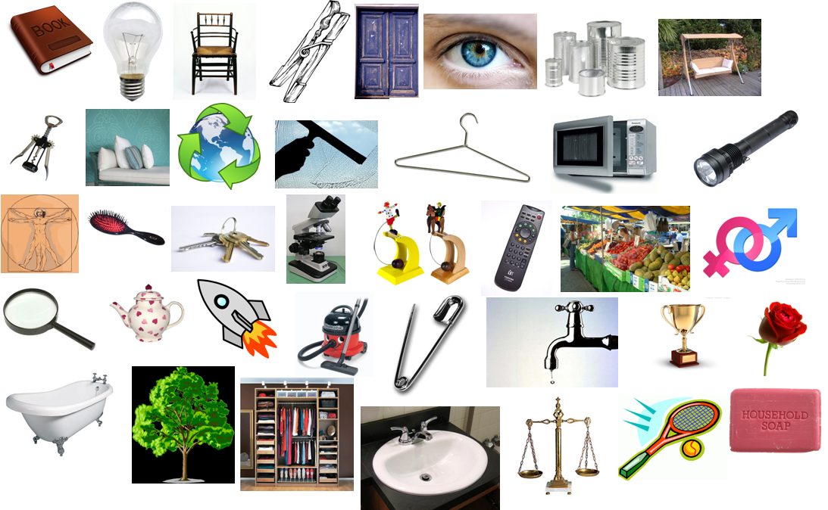
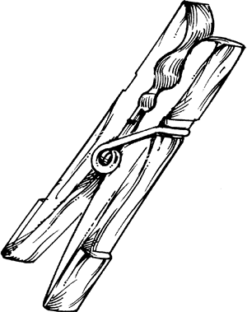
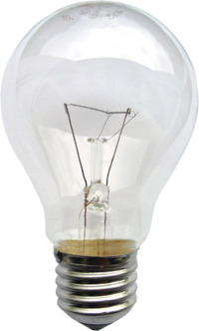
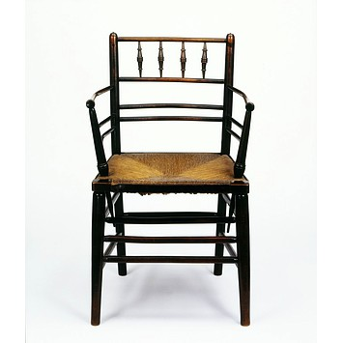
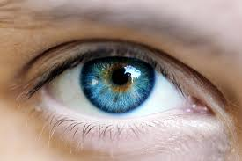
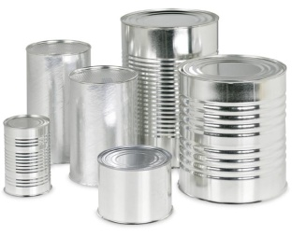
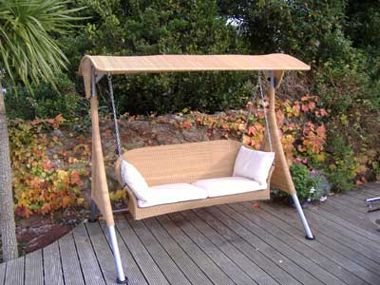
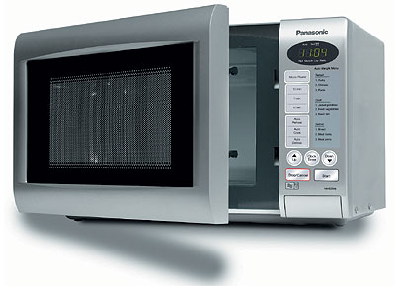
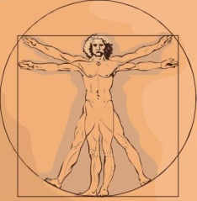
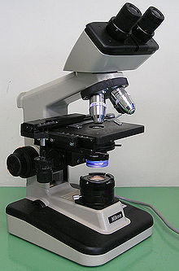
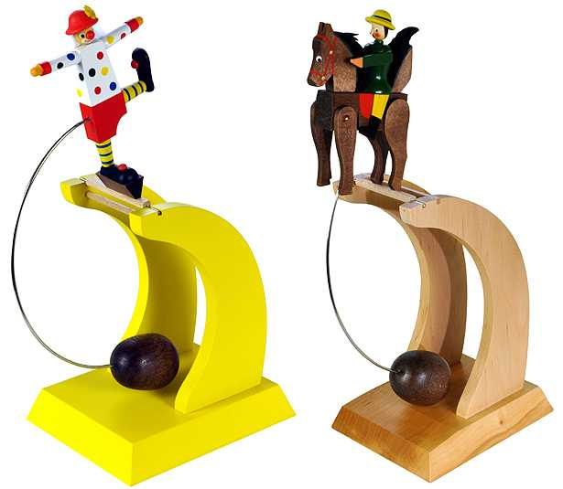
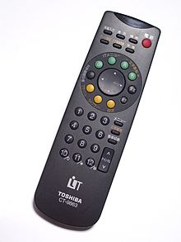
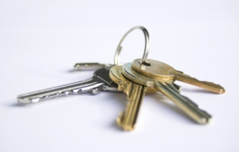
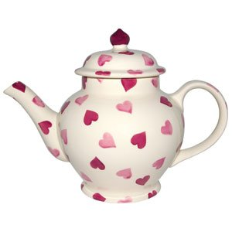
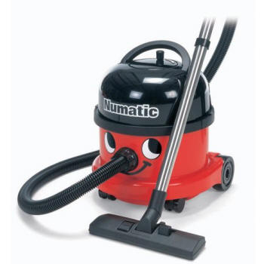
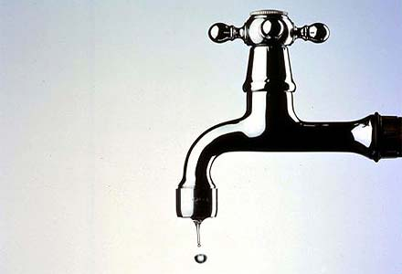
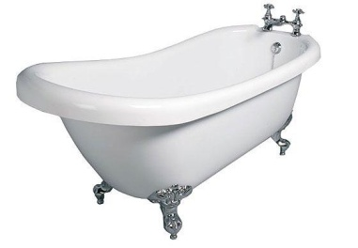
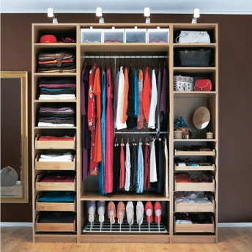
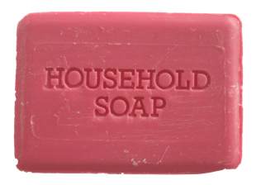
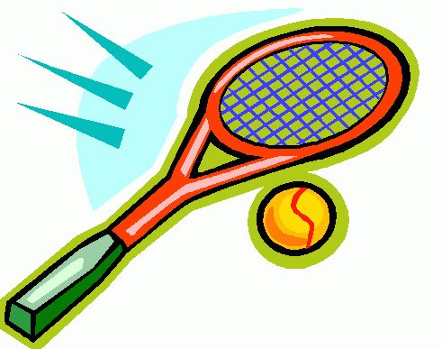
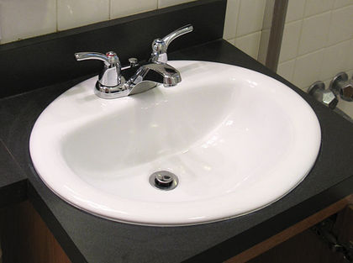

Slide 24
5 Evaluation (Diamond Nines)

Slide 25
Evaluation Diamond Nines
Diamonds helps you make judgements about what is important in a particular topic and to give reasons for your judgements
The boxes are arranged on 5 levels of importance from the single most important to the single least important

Slide 26
Rank the 9 elements you are given by what you think are the most important. You can record your reasons alongside to use later
1
2
2
3
3
3
4
4
5

Slide 27
Which of these is the most important factor in passing exams?
Planning Motivation
Intelligence Practise
Listening Memorising
Perseverance Effort
Processing
Homework

Slide 28
6. Active learning

Slide 29
Passive learner Active learner
- You do just enough work at home so you don’t get in trouble from your teachers
- You play around in class, chat, disturb other people, have a ‘can’t be bothered’ approach, you put little effort into making yourself focus and work effectively in class
- You talk when others are talking and even if not talking you are daydreaming
- You realise you are working for yourself now, not for teachers or parents or anyone else – it is your future and your life
- You work in class so that you have less to do at home and more time to do the things you want to do, and also so that you get the best understanding that you can of the subject and so that your friends and classmates can also have a good chance of doing well without you making it more difficult for everyone
- You listen to what your teacher and other students say in class and contribute your thoughts too, making the most of the classroom environment

Slide 30
7. Health/Fitness/Diet
Healthy lifestyle:
Diet – healthy foods
Regular exercise
Sleep
Relaxation

Slide 31
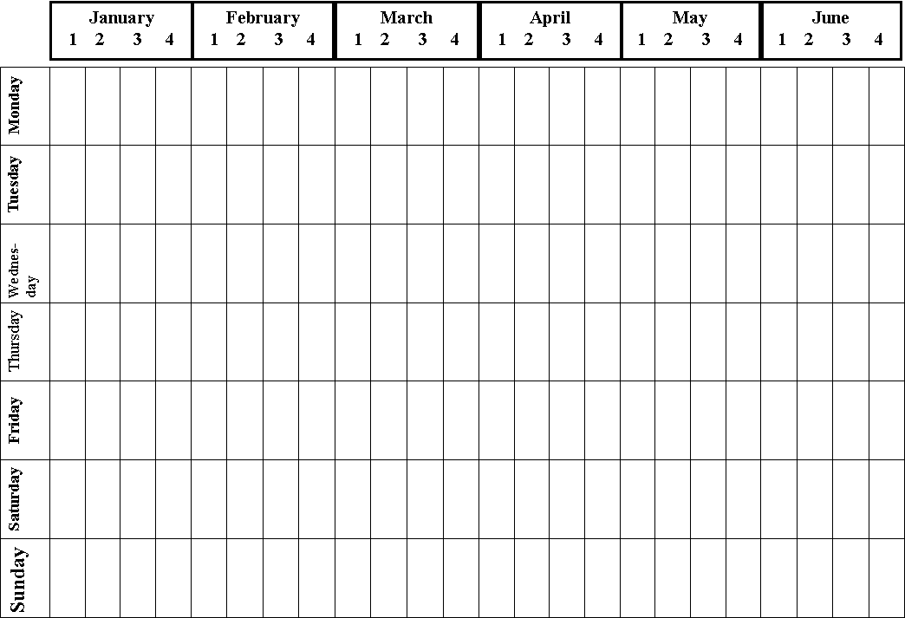
8. Time Management and Planning

Slide 32
9. Motivation, Managing Stress and Barriers to Study
Motivation
Reward
Bite size chunks
The ‘Nike’ Technique: Just Do It
Long term gain with short term pain

Slide 33
Technique | What does this technique involve?
Relax yourself | Give yourself permission to relax and take the time to do things you enjoy and that relax you. Schedule time on a regular basis for these activities.
Take mini-breaks | Take a few moments out of your day on a regular basis to close your eyes, breathe deeply and slowly with a smile on your face.
Do something active | Exercise can help get rid of stress so make time to do active things like playing sport or going for a walk.
Spend time with people whose company you enjoy | Spending time with other people makes you feel happier! Give a friend a call or see people you like on a regular basis.
Positive self-talk | Talk positively to yourself and watch out for negative thoughts – immediately replace them with positive ideas.
Friends and family | Rather than take out your frustrations on the people closest to you, talk to them and tell them what you are feeling.
Get organised | Develop a daily schedule of activities that is realistic and achievable. Make a daily to-do list. Identify your priorities and what is most important to you and stick to your list.
Write down your thoughts | Use a journal, write a letter to yourself or to someone else (and you don’t even have to post it). You could also send an email or write a list of what is bothering you – getting your thoughts down on paper helps!
Mountains vs molehills | Imagine a ruler marked 1 to 100 and think of all the things that are not good in the world. Where at the moment is the thing that is making you feel bad on this scale compared to the worst things that could ever happen? This reminds us that reality is not as bad as it seems.
Laugh out loud | Look for opportunities in your day to laugh and to smile. Be around people who are happy and positive rather than misery-guts. Do things that make you laugh like watching a comedy.
Deal with anger | Express your anger in a healthy way: talk to someone about how you are feeling, write in a journal, express yourself through art, punch a pillow, find somewhere where no-one is around and scream out loud, do some vigorous exercise, write a letter (don’t post it)
Breathe deeply | Imagine there is a balloon in your stomach. As you inhale you fill it up, when you exhale you deflate the balloon. Your chest and shoulders should not be a part of the process – they should be relaxed. Ensure you breathe slowly and smoothly.
Celebrate yourself | Feel good about yourself and our achievements! Reward yourself for the things you do and look for your positive qualities and strengths – give yourself encouragement. Take pride in yourself and your skills and abilities. Accept yourself for who you are and what you are and set realistic expectations for yourself.
Cross the word ‘failure’ out of the dictionary | Stop thinking of things in terms of success and failure. When things don’t go the way you want, instead think of what you can learn from the experience and what steps you will take next to move towards your goal.
Look for beauty | Slow down and take in the beauty of the world around you. It is amazing what you will see if you start looking for things you can enjoy.
Be grateful | Think about the things you have in your life that you are grateful for. Each day remind yourself of these things and be thankful.
Meditation and relaxation exercises | Try different forms of meditation and relaxation until you find ones that suit you – but be patient, it takes practice to be able to switch off your brain and relax.
Use visualisations | Create positive mental movies in your mind of how you would like things to be and imagine these as vividly and regularly as possible.

Slide 34
Relax yourself
Take mini-breaks
Do something active
Spend time with people whose company you enjoy
Positive self-talk
Friends and family
Get organised
Write down your thoughts
Mountains vs molehills
Laugh out loud
Deal with anger
Breathe deeply
Celebrate yourself
Cross the word ‘failure’ out of the dictionary
Look for beauty
Be grateful
Meditation and relaxation exercises
Use visualisations

Slide 35
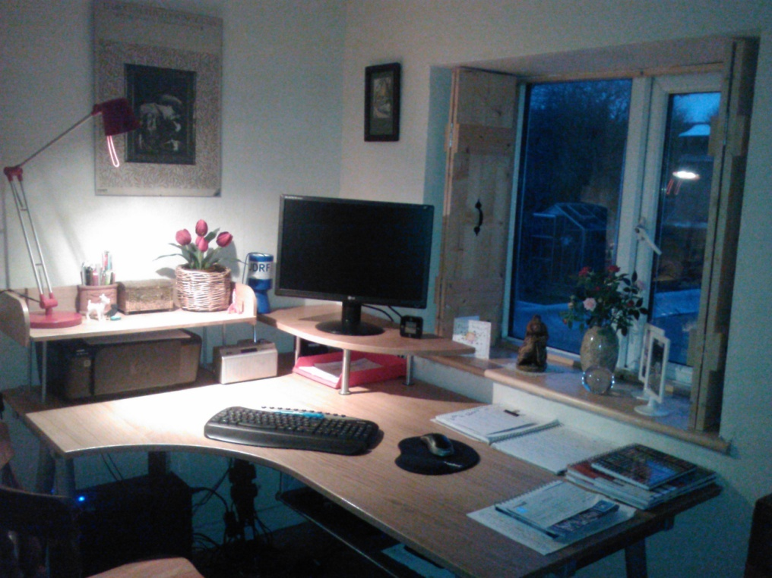
10. Environment

Slide 36
The ideal conditions for your home study environment are as follows:
Good Lighting
Clear Workspace
Storage
Ventilation
Ergonomics
Quiet/Private
Distraction Free
Music
Supportive Chair

Slide 37
The reluctant learner
The six-o’clock-in-the-evening-enthusiastic-determined-and well-intentioned-studier-until-midnight is a person with whom you are probably already familiar. At 6pm the student approaches his (or her) desk, and carefully organises everything in preparation for the study period to follow. Having everything in place, he next carefully adjusts each item again, giving him time to complete the first excuse
He’ll read all articles of interest in the newspaper
Now he has such small things completely out of the way before settling down to the task at hand
Then it seems like a good idea to plan for the evening’s first break – perhaps an interesting programme between 8 – 8.30pm
He finds the programme, and it inevitably starts at about 7pm
He returns to his desk at 7.45pm, because the beginning of the next programme was also a bit more interesting

Slide 38
He remembers that phone call and text messages from two fellow students, these are best cleared out of the way before the serious studying begins
The phone call and texts are coming back and forth, of course, are much more interesting and longer than originally planned, but eventually the intrepid studier finds himself back at his desk at about 8.30pm
He actually sits down at the desk, opens the book with a display of physical determination and starts to read (usually at page one) as he experiences the first pangs of hunger and thirst
The snack becomes a feast
Having removed his final obstacle, he returns to his desk The first couple of sentences on page one are looked at again... as the studier realises that his stomach is feeling decidedly heavy and a general drowsiness seems to have set in. Far better at this juncture to watch that other interesting half hour programme at 10pm

Slide 39
At midnight we find him asleep in front of the TV
Even at this point, when he has been woken up by whoever comes into the room, he will think that things have not gone too badly, for after all he had a good rest, a good meal, watched some interesting and relaxing programmes, fulfilled his social commitments to his friends, digested the day’s information, and got everything completely out of the way so that tomorrow at 6pm...

Slide 40
The Big Enemy
Procrastination

