Slide 1
NATIONAL CAREERS WEEK 1 – 6 MARCH 2021 ST BEDE’S CHS

Slide 2
HERE IS YOUR CHANCE TO FIND OUT ABOUT THE DIFFERENT CAREERS AVAILABLE
2021
NOW
WHERE DO I SEE MYSELF IN 10 YEARS TIME?
WHAT HAVE I GOT TO DO TO GET THERE?
2026
AM I DOING THE RIGHT THINGS TO GET TO WHERE I WANT TO BE?
HAVE MY IDEAS CHANGED?
2031
HAVE I ACHIEVED WHAT I SET OUT TO DO?
AM I ON TRACK?

Slide 3
https://vimeo.com/509325682

Slide 4
https://vimeo.com/393837020 IF YOU DO NOTHING ELSE, WATCH THIS FILM CLIP! FEELING STRESSED IS NORMAL. PLEASE DON’T WORRY. YOU WILL FIND YOUR WAY IN LIFE!

Slide 5
https://www.unitedutilities.com/site-tour

Slide 6
file:///C:/Users/lt01/Downloads/ncw-2020-rsc-booklet.pdf
Careers in Chemistry
Lots of information for you in the link to this booklet!

Slide 7
https://vimeo.com/487330866/487325994
ARMY CAREERS
This links you to some video clips of the different careers in the army and how to apply.

Slide 8
https://www.bbc.co.uk/bitesize/careers
BBC BITESIZE
INFORMATIVE AND EASY TO USE WEBSITE
LOTS OF INFORMATION ON JOBS, APPLICATIONS, CVs AND INTERVIEWS
LINKS TO INFORMATION ON APPRENTICESHIPS, COLLEGE AND UNIVERSITY
WELL WORTH A LOOK!!

Slide 9
https://www.healthcareers.nhs.uk/FindYourCareer
CLICK ON THIS LINK TO FIND OUT WHAT NHS CAREER MIGHT SUIT YOU

Slide 10
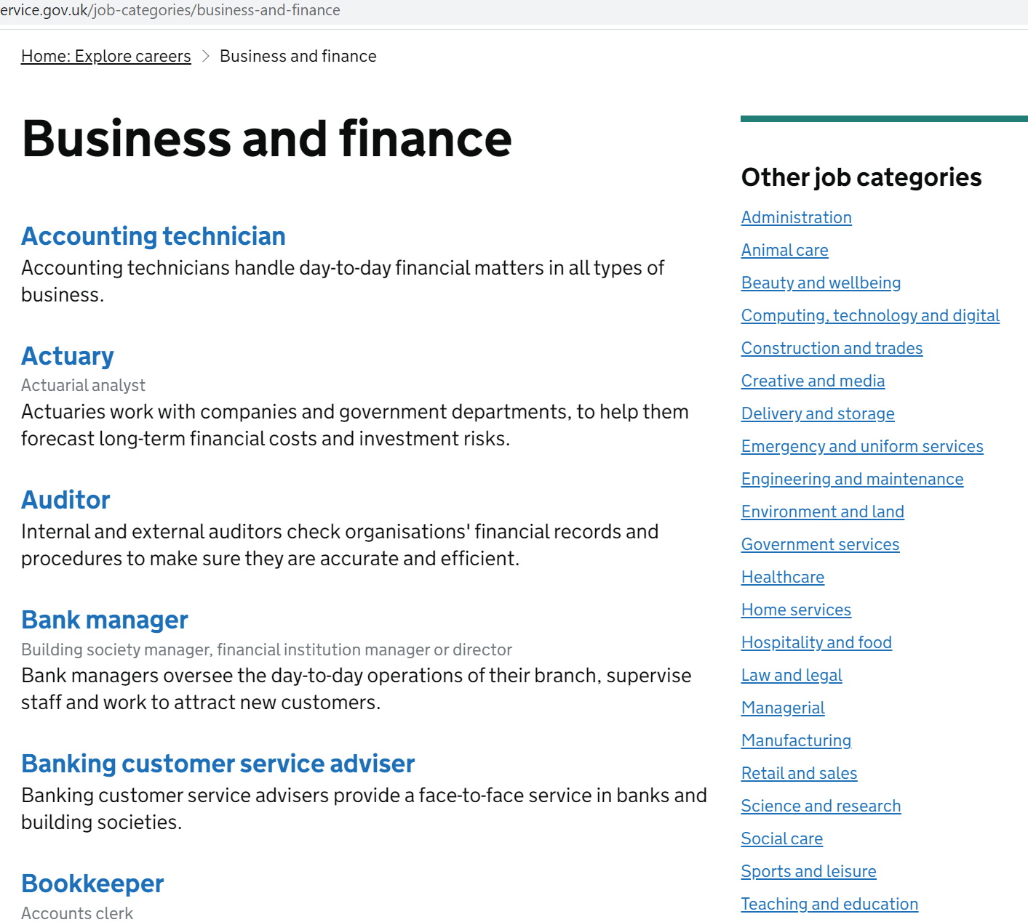
CAREERS IN FINANCE IS MATHS YOUR THING? CHECK OUT THESE CAREERS!
https://nationalcareers.service.gov.uk/job-categories/business-and-finance

Slide 11
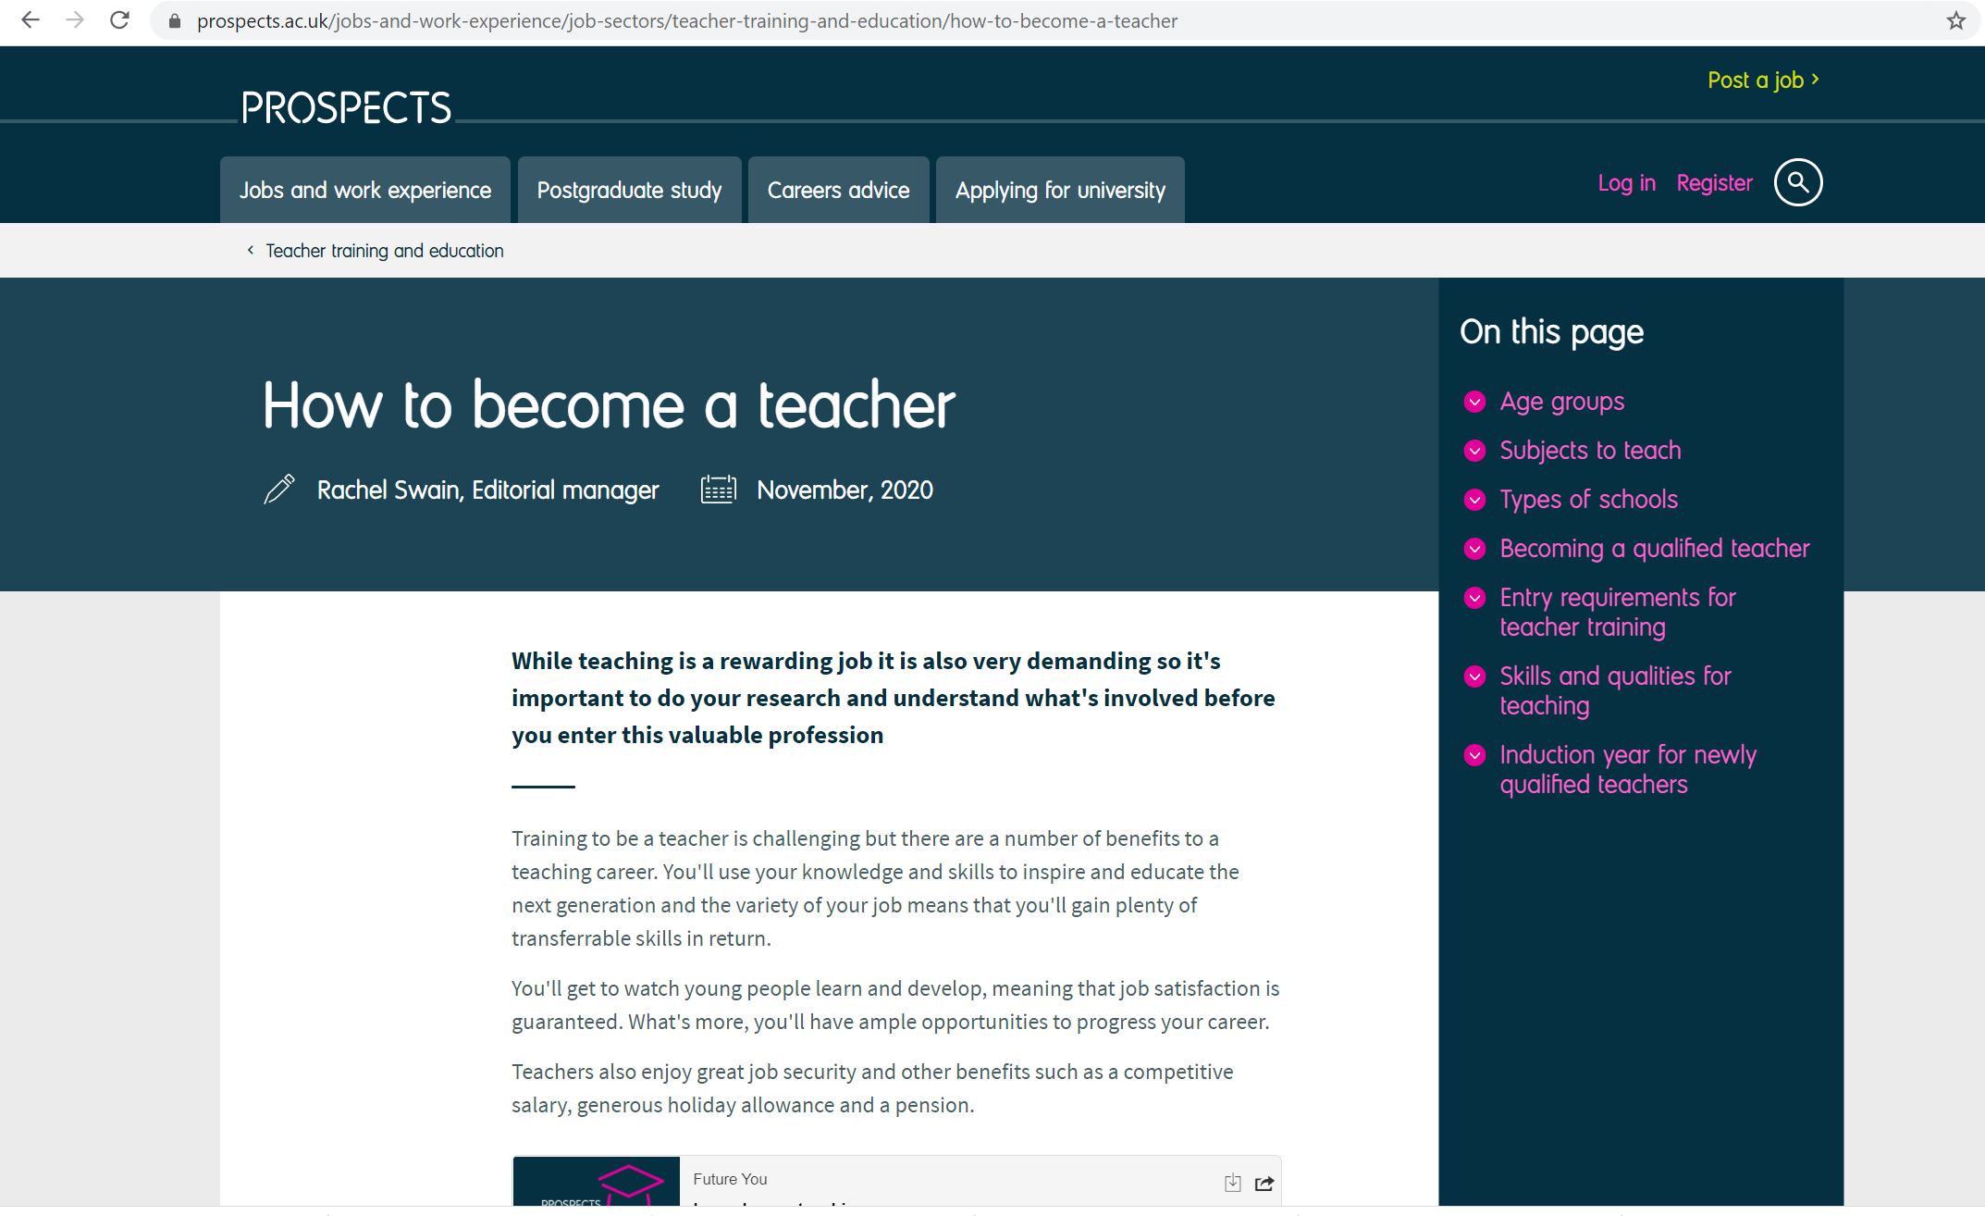
https://www.prospects.ac.uk/jobs-and-work-experience/job-sectors/teacher-training-and-education/how-to-become-a-teacher HOW ABOUT TEACHING?

Slide 12
file:///C:/Users/lt01/Downloads/Careers%20Week%20Document%201-5%20March%202021.pdf
WEST LANCS COLLEGE HAVE PUT TOGETHER SOME INFORMATION FOR YOU TOO!
“ I I have listed careers and linked them to skills using Career Coach. This allows pupils to explore jobs in the area. I have also linked our mini videos which highlight careers but also have some student testimonials which pupils may relate to. Finally I have linked the document to the National Careers Service Website, Prospects Website plus some more subject specific sites to help pupils start to think about their future.”
Dawn Hughes

Slide 13
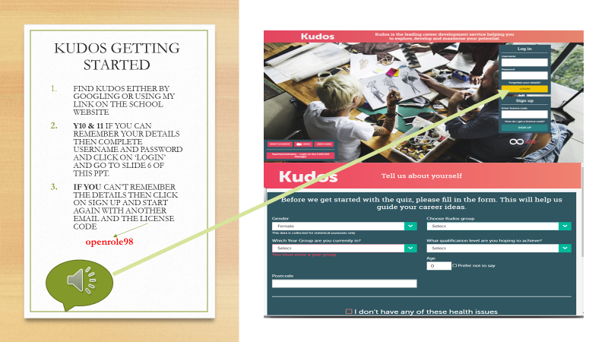
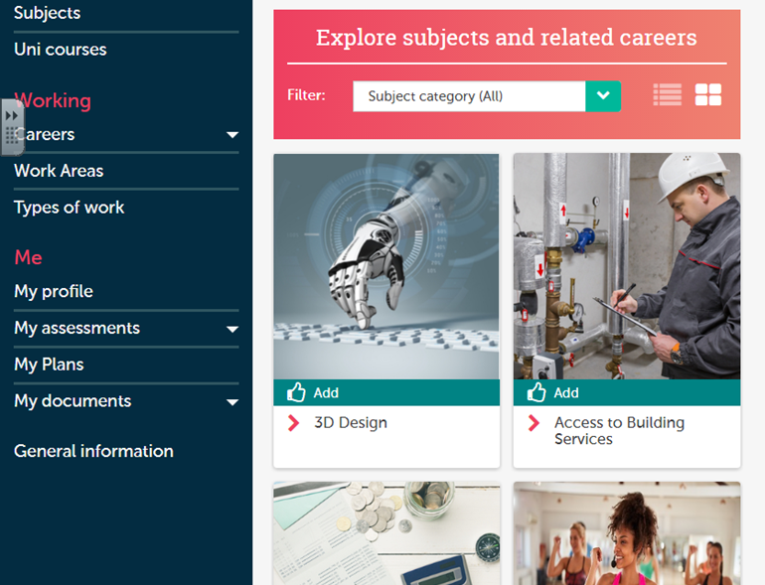
DON’T FORGET KUDOS!
LOGGING ON AND COMPLETING THE QUESTIONNIARE AGAIN CAN BE VERY HELPFUL.
OR YOU CAN EXPLORE CAREERS BY A SUBJECT AREA YOU LIKE!

Slide 14
https://forms.office.com/Pages/ResponsePage.aspx?id=ZFzxzadTiU-BCKwXFk6709Ui6uloUnNLiNJ6c_EvG1hURUpHTFRVTUM2MVdPVjUzTlY2VEEyQlRQSy4u
HERE IS A LINK TO A QUICK SURVEY FORM FOR YOU TO DO.
THANKS FOR LOOKING THROUGH THE INFORMATION – I HOPE YOU FOUND IT USEFUL!
MRS TURPIN

