Slide 2
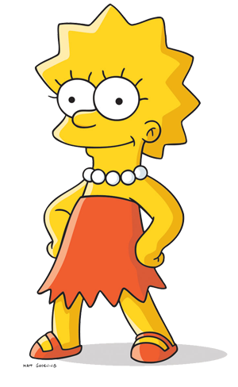
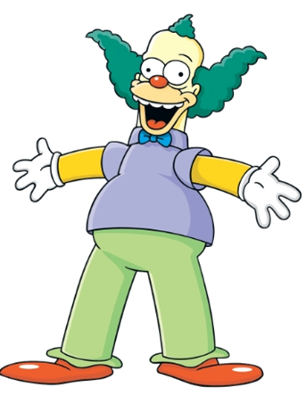
There's no point in trying if I'm going to fail
Either I'm good at something, or I'm not
I can't make this any better- It is what it is
I can't learn now- It's too late

Slide 3
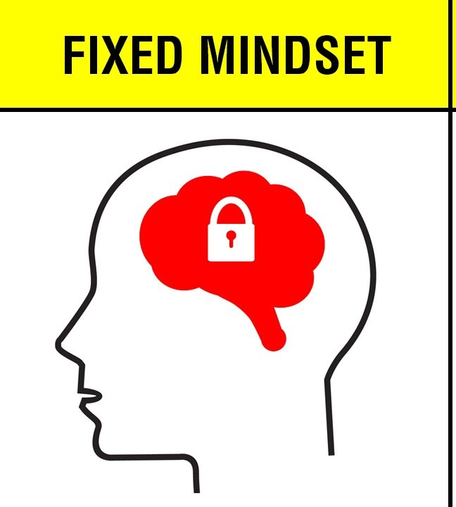

Slide 7
Is genius born or made?
What do you think….?

Slide 8
https://www.youtube.com/watch?v=CZiSxfCmOZY

Slide 10
Effort makes me stronger

Slide 11
Learning
is my goal

Slide 12
Instead of saying …
Try thinking…
I give up
Plan A didn’t work
It’s good enough
It’s good enough
It’s good enough
This may take some time
I can always improve
I can’t make this any better
This is too hard
This is too hard
This is too hard
I will learn from them
My friend can do it
I’ll use a different strategy
My friend can do it
My friend can do it
There’s always Plan B
I made a mistake
I made a mistake
I made a mistake
Is this really my best work
I’ll never be that smart
I will learn how to do this
I’m not good at this
I’m not good at this
I’m not good at this
Mistakes help me to learn
What am I missing?
I just can’t do this
I am going to train my brain
I just can’t do this

