Slide 1

Getting Ready for September
Ratio

Slide 4
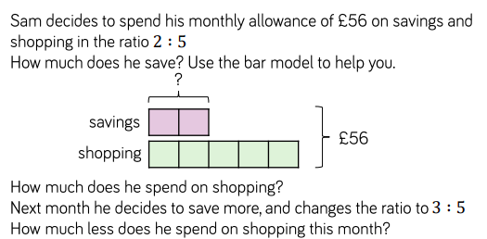

Slide 5
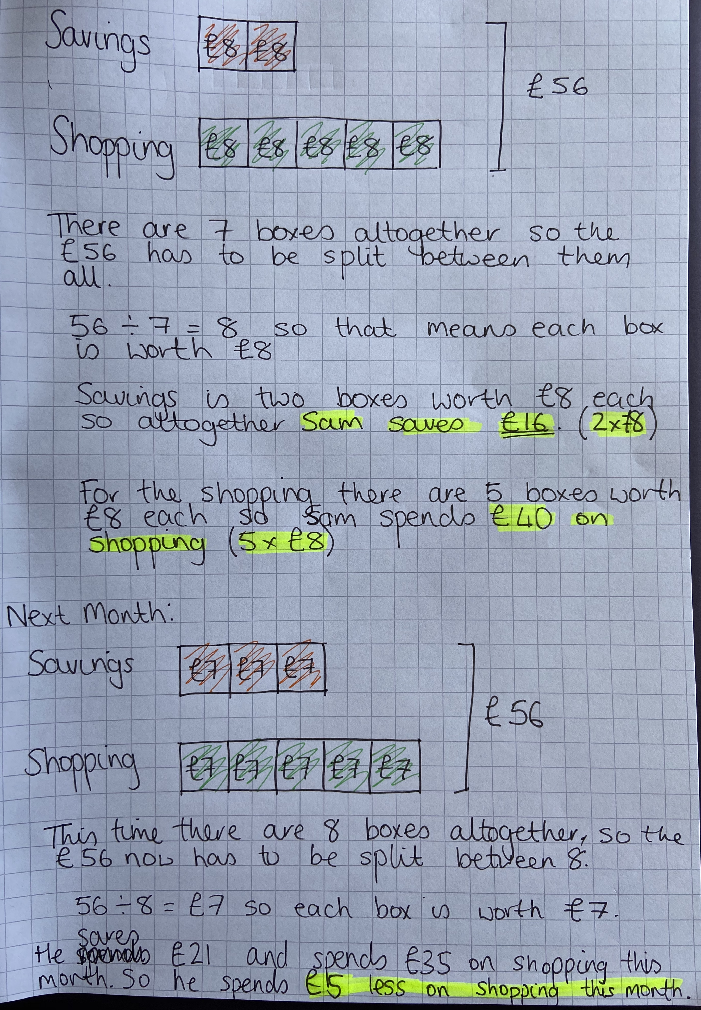
Sam saves £16
Sam spends £40 on shopping
The following month, Sam spends £5 less on his shopping.

Slide 6
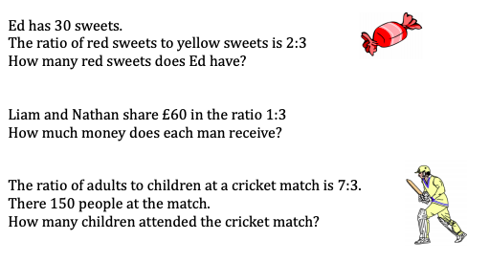
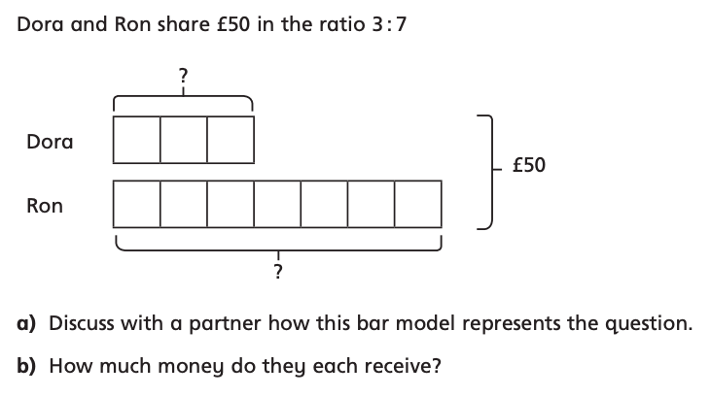
Share £20 in the ratio 2:3

Slide 7

12cm²
11, 13, 17 and 19
A and F
4575
49

Slide 8
3, 6, 9, 12 and 15
5 + 2 = 7
1 + 2 = 3
21 + 10 = 31
And so on …
1013
45 minutes

Slide 9
Share £20 in the ratio 2:3
Liam receives £15 and Nathan receives £45
£8 : £12
Ed has 12 red sweets
There are 45 children at the cricket match.
There are £50 needs to be split between the 10 boxes so that means each box is worth £5.
Dora gets 3 boxes of £5 so £15 and Ron gets 7 boxes of £5 so £35.

