Slide 1
Fracking in the UK Activity 1
What is fracking?
Why are we doing it?
Who is for?
Who is against?
This work links in with the Resources in the UK topic (paper 2, section C) so you will be able to use it for revision purposes in the future.

Slide 2
What is fracking?
Fracking is the process of drilling down into the earth before a high-pressure water mixture is directed at the rock to release the gas inside.
Water, sand and chemicals are injected into the rock at high pressure which allows the gas to flow out to the head of the well.
The process can be carried out vertically or, more commonly, by drilling horizontally to the rock layer, which can create new pathways to release gas or used to extend existing channels.
The term fracking refers to how the rock is fractured apart by the high-pressure mixture.

Slide 3
How does it work?

Slide 4
How does it work?
https://www.youtube.com/watch?v=Tudal_4x4F0
Watch the you tube clip to learn more about the fracking process.
If the clip doesn’t work type ‘How does fracking work’ into you tube. It’s the first clip that comes up. The TED-Ed one that’s about 6 minutes long.

Slide 5
Fracking in the UK - Task
You are going to undertake some research surrounding the issue of fracking in the UK. Write up your findings as a knowledge organiser (either on paper or use the computer). It is important that you do this well because you will be using the information during activity 2.
There are some examples of knowledge organisers on the next slides so you can see how they’re set out.

Slide 6
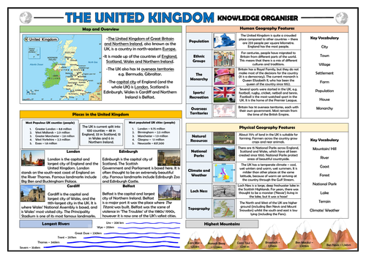
Example 1

Slide 7
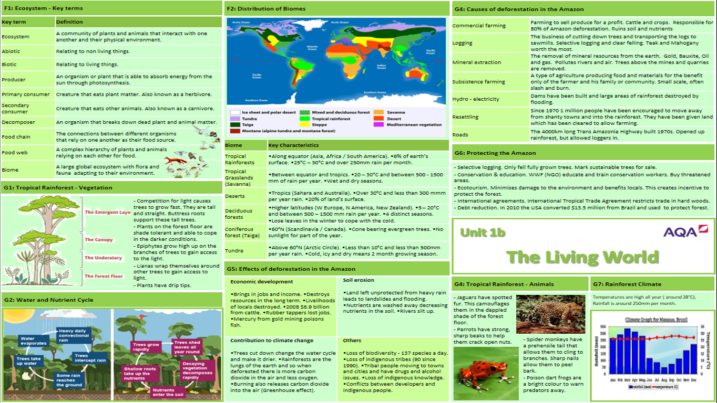
Example 2

Slide 8
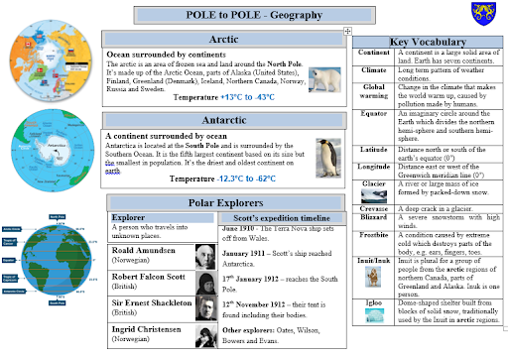
Example 3

Slide 9
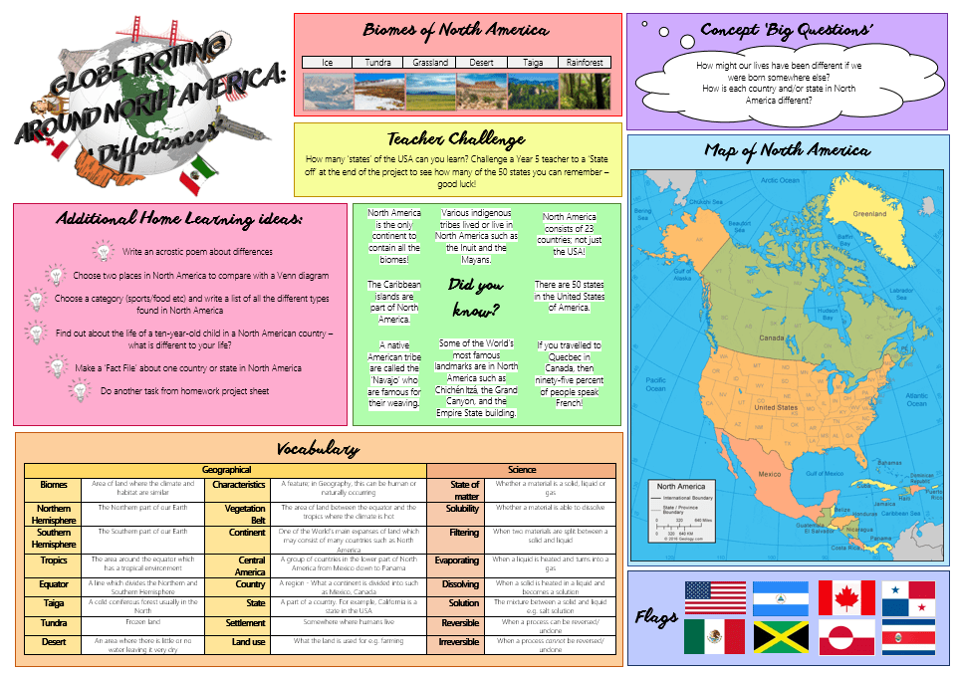
Example 4

Slide 10
What should I include?
What is fracking?
How does fracking work? (Include a diagram if you can)
Why the UK is choosing fracking as a way to get energy. I.e. why are we doing this?
Where are the UK’s fracking sites located? (Include a map if you can)
What are the advantages? – who likes it/wants fracking? Why? (Think about various groups of people e.g. fracking companies, governments etc.) Also consider social economic and environmental issues.
What are the disadvantages? – who dislikes it/doesn’t want it? Why? (Think about various groups of people e.g. local residents, environmental organisations etc.) Also consider social, economic and environmental issues.
The advantages and disadvantages are VERY important – they should be the most detailed part of your knowledge organiser.

Slide 11
Useful websites to get you started
Here are a few websites to help get you started with your research. (You can use others too).
https://www.bbc.co.uk/news/uk-14432401
https://www.bbc.co.uk/news/topics/cljev4k5jy2t/fracking
https://selectra.co.uk/energy/guides/environment/fracking-pros-cons
https://www.theguardian.com/environment/2013/dec/19/uk-fracking-shale-gas
https://www.greenpeace.org.uk/challenges/fracking/
https://www.theguardian.com/environment/2019/sep/10/extinction-rebellion-blocks-uk-fracking-site-in-climate-protest-preston-cuadrilla
https://frack-off.org.uk/
https://www.nationalgeographic.com/environment/energy/great-energy-challenge/big-energy-question/how-has-fracking-changed-our-future/
Remember to use reputable sources of information for your research.

