Slide 1


Dare to Dream

Slide 2

Family Bucket List

Slide 3

Vision board

Slide 4
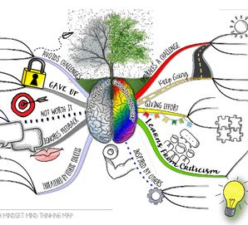
Attributes to succeed.

