Slide 1
The History of the Future: Living Through Lockdown Project

Slide 2
Recording your own views for the future…
One way to ensure your views and experience of the crisis are represented and available to future historians is to record them now!
One of the best sources of information we have about the Great Plague of 1665 is the diary of Samuel Pepys. You can read extracts here: pepysdiary.com/diary/summary/1665/.
Record your own viewpoint of the 2020 pandemic by producing your own historical record.

Slide 3
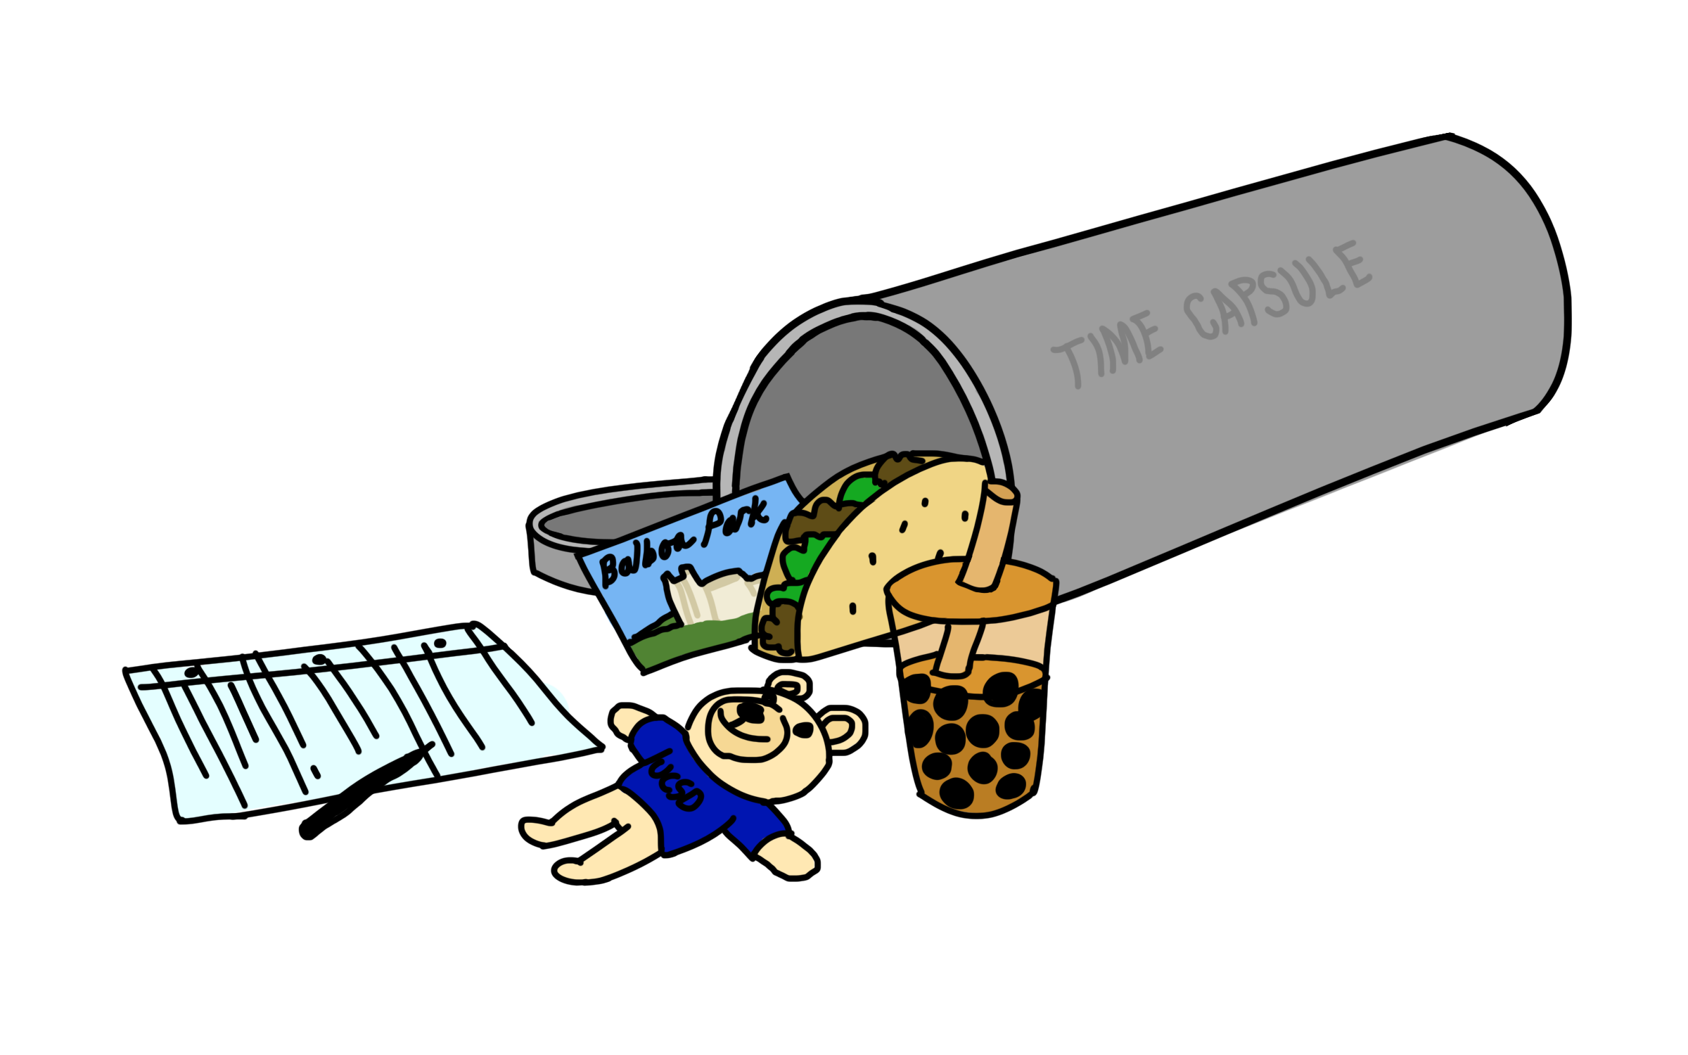
Task ideas
Create your own power point with voice over telling the story through your eyes
Create a collage/ poster reflecting this time in History
Create your own time capsule list of contents
Create a booklet/ scrap book of your ideas, thoughts and images
Create your own movie maker film
Record a video message for the future

Slide 4
A picture paints a thousand words……
Find six pictures which you think would tell a future historian a lot about the current situation.
Try to choose a range that show how different groups of people were affected in different ways and in different parts of the world.
Remember the phrase ‘a picture paints a thousand words’ … choose wisely!

Slide 5
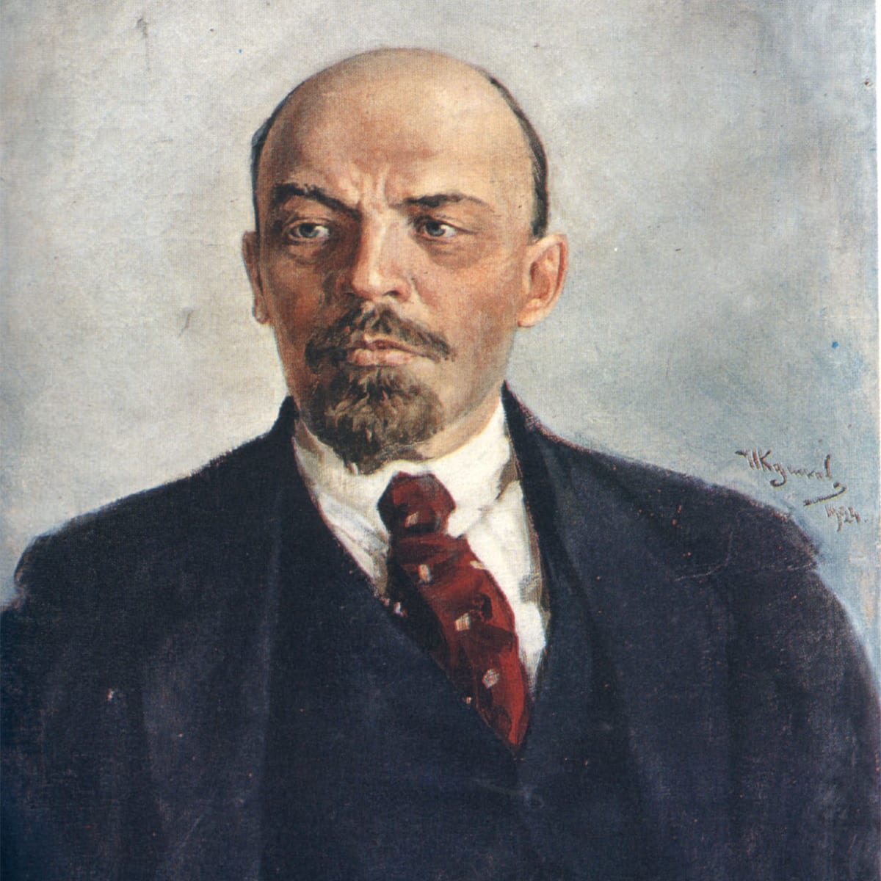
Coronavirus timeline
‘There are decades where nothing happens; and there are weeks where decades happen’.
Vladimir Lenin
November/ December 2019
January 2020
February 2020
March 2020
April 2020
May 2020
July 2020

Slide 6
How did different countries respond to the crisis?
What lockdown restrictions did they put in place and when?
How did they try to support their citizens?
UK
CHINA
USA
GERMANY
INDIA
Find 3 key facts about how each of these countries responded to the pandemic.

Slide 7
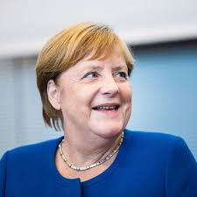
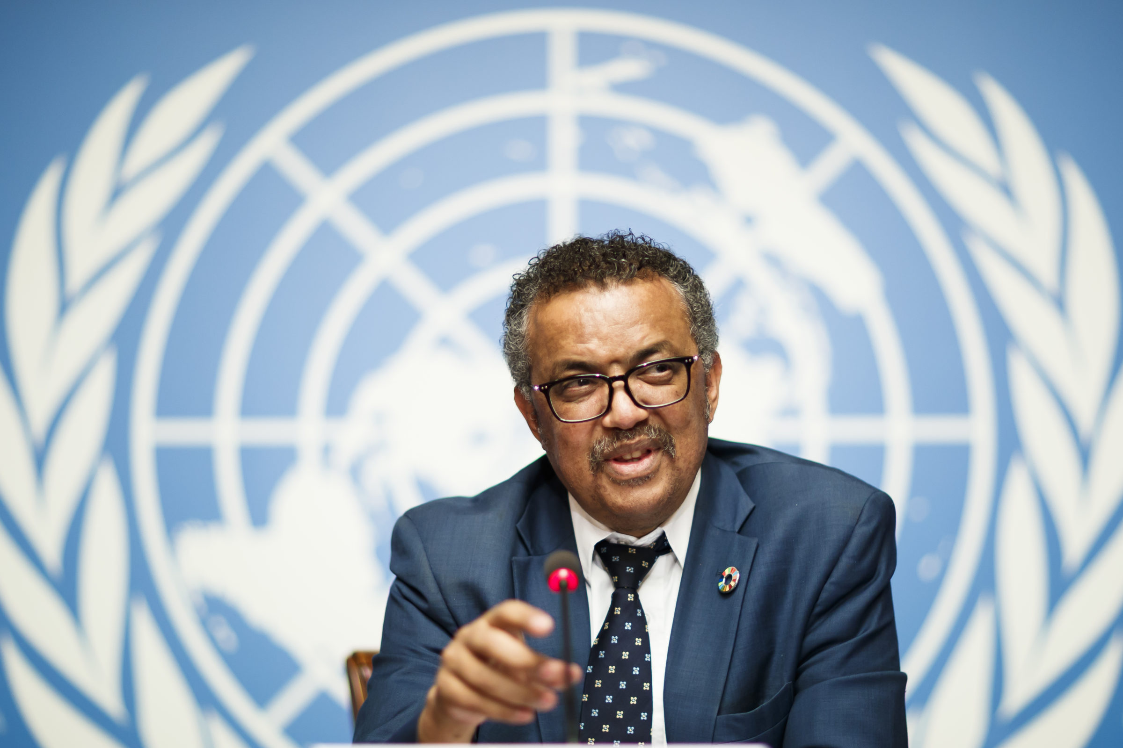
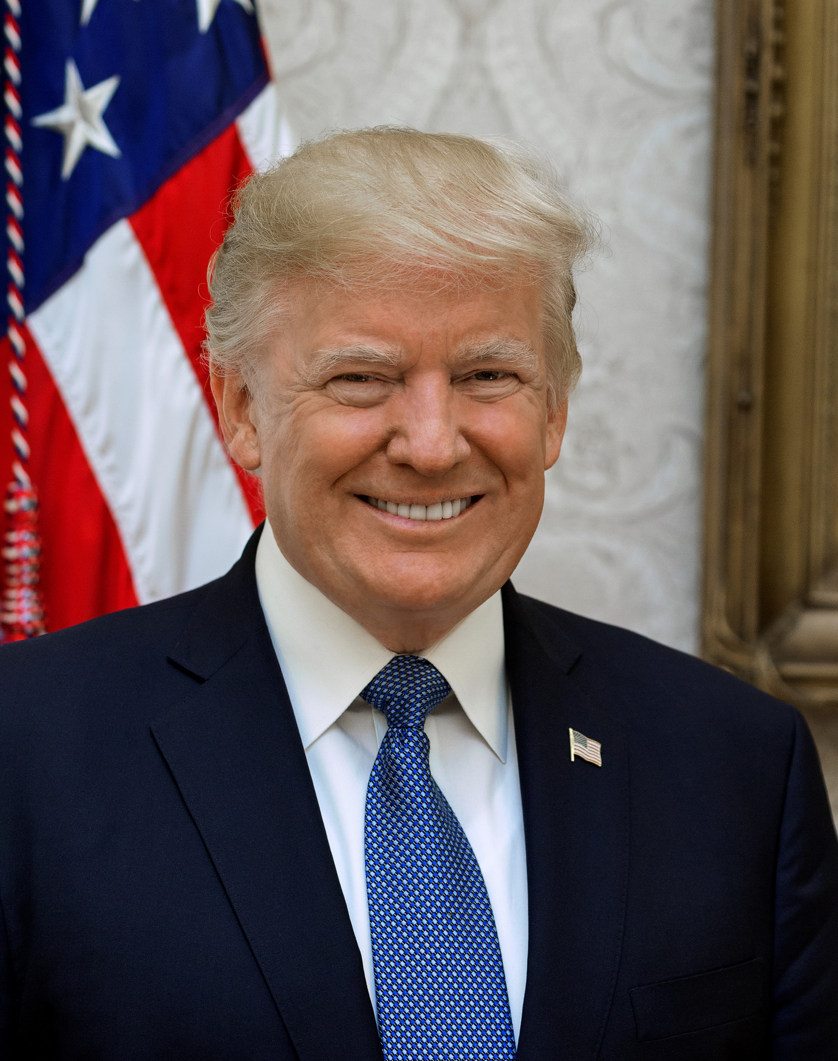
What did the leaders have to say?
Boris Johnson (UK)
Angela Merkel (Germany)
Donald Trump (US)
Dr Hedros Adhanom (Director General of the World Health Organisation
In difficult times, one of the jobs of world leaders is to speak on behalf of their people, to explain what their government is doing, and to encourage their people to act in certain ways.
Find some examples of what the following world leaders have had to say about coronavirus and their people’s attempts to fight it:

Slide 8
How long have you been in lockdown so far?
Can you remember your first thought when you heard that schools were closing? Were you thrilled? Concerned? Frightened? Why?
What about when you heard we were going into lockdown?
What do you miss most about normal life?
What are the biggest disadvantages, in your opinion?
Do you think lockdown will change us all? If so, how?
What do you think you will remember most about this moment in history?

Slide 9
What long term changes might the crisis bring about? Your predictions
Historic events tend to speed up change and change the way we do things. The First World War, for example, led to massive medical advances. The Second World War led to the establishment of the NHS.
How do you think the following areas might be affected by the pandemic in the longer term?
The environment
The economy
Politics
Inequality
The position of women
Healthcare

