Slide 1
Getting Ready for September
Year 11 German
Task 1
Listening for vocabulary and grammar

Slide 2
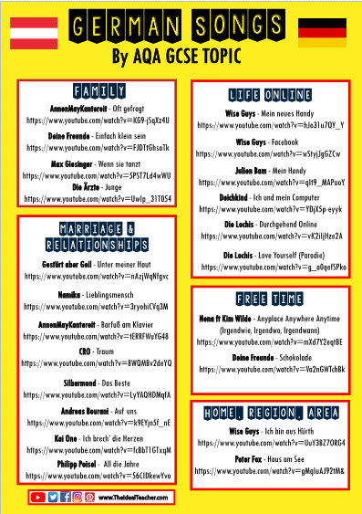
Copy and paste one song from each topic into google.
Search for the lyrics for the song.
Look up key words
Try to see what the song is about!

Slide 3
Copy and paste one song from each topic into google.
Search for the lyrics for the song.
Look up key words
Try to see what the song is about!

Slide 4
Copy and paste one song from each topic into google.
Search for the lyrics for the song.
Look up key words
Try to see what the song is about!
For the grammar songs, if you have a gap in your knowledge, use https://www.languagesonline.org.uk/Hotpotatoes/germanindex.html#Grammar for practice

