Slide 1
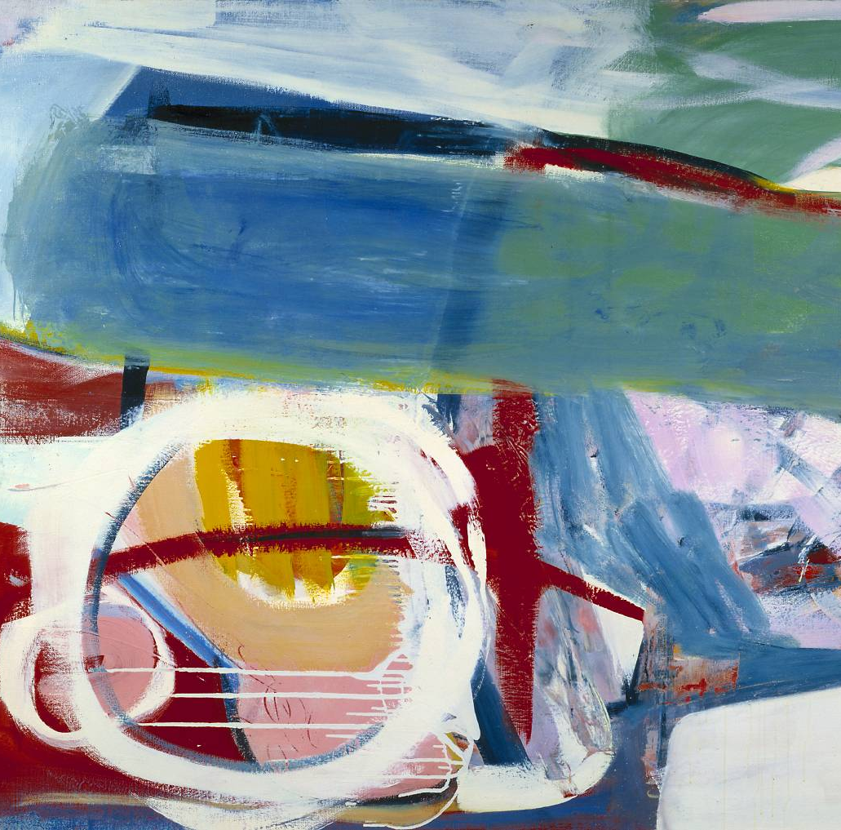
GCSE Art & Design
AQA

Slide 2
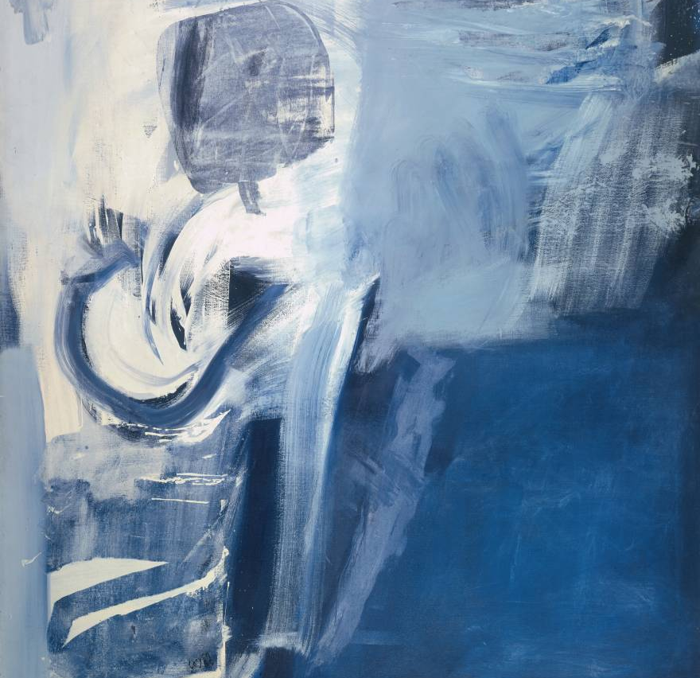
Assessments – What you have to do.
Component 1:
Portfolio + What's assessed
A portfolio that in total shows explicit coverage of the four assessment objectives.
It must include a sustained project (Natural Forms) evidencing the journey from initial engagement to the realisation of intentions and a selection of further work undertaken during the student’s course of study (Unit 1 Exam project).
How it's assessed
• No time limit
• 96 marks
• 60% of GCSE Non-exam assessment (NEA) set and marked by the school/college and moderated by AQA during a visit.

Slide 3
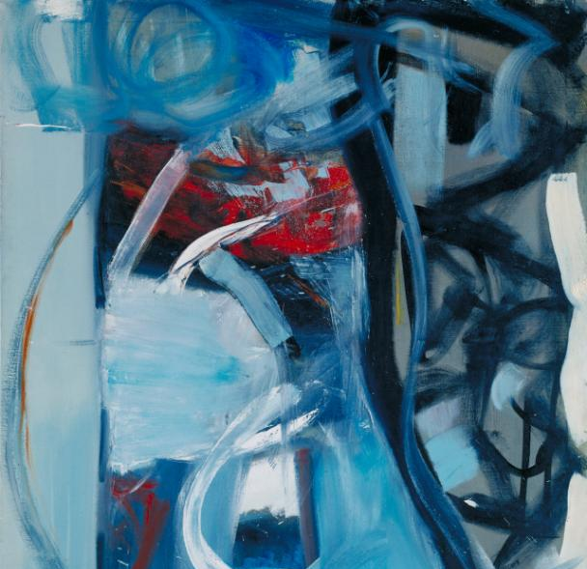
Assessments – What you have to do.
Component 2:
Externally set assignment
What's assessed
Students respond to their chosen starting point from an externally set assignment paper relating to their subject title, evidencing coverage of all four assessment objectives.
How it's assessed
• Preparatory period followed by 10 hours of supervised time
• 96 marks
• 40% of GCSE Non-exam assessment (NEA) set by AQA; marked by the school/college and moderated by AQA during a visit. Moderation will normally take place in June.

Slide 4
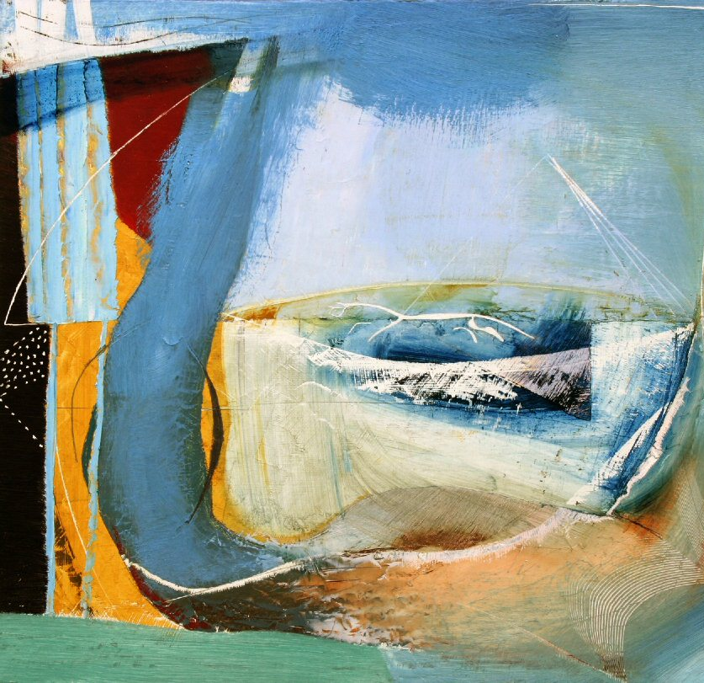
Assessment Objectives
AO1: Develop ideas through investigations, demonstrating critical understanding of sources.
• AO2: Refine work by exploring ideas, selecting and experimenting with appropriate media, materials, techniques and processes.
• AO3: Record ideas, observations and insights relevant to intentions as work progresses.
• AO4: Present a personal and meaningful response that realises intentions and demonstrates understanding of visual language.

Slide 5
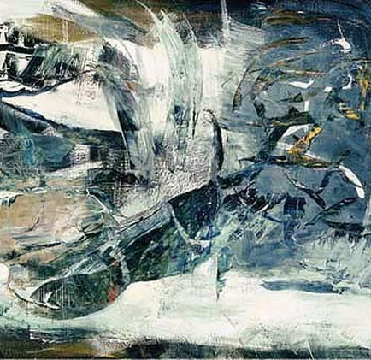
How to get a grade 9
https://www.youtube.com/channel/UCKagHi4tnRi3ILoE9Y2e7Wg
There are a lot of You Tube videos by past pupils who have been awarded a Grade 9.
Watch some of these to get some inspiration for your GCSE work.

Slide 6
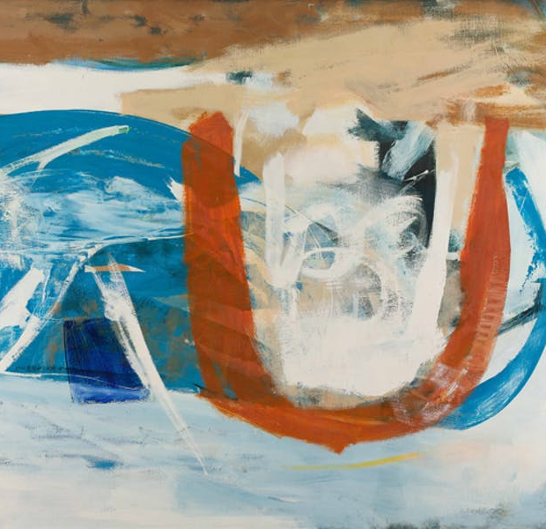
Your Summer Holiday Task
https://www.youtube.com/watch?v=hyU9jb3KdY4&t=6s
Watch this You Tube Clip and follow the instructions to create a double page of work.

