Slide 1
Spring Term
Week commencing 20th January 2020.
Sir David Attenborough BBC
Interview.

Slide 2
How does this news event/situation
make you feel?
Do you see kindness , equality and justice here?
What do you think is good here?
Is there any thing unjust, unfair or wrong about this situation?
What do you think is wrong here?
What positive qualities and values should this situation arouse in us as people who care about the needs of others?
Empathy? Mercy? Compassion? Kindness?
Love? Accountability? Forgiveness?
Hope?
Faith?
https://www.bbc.com/news/science-environment-51123638

Slide 3
Scripture. What does God say? | Put Your Faith Into Action. What can YOU do?
“You shall not pollute the land…” Numbers 35:33 “The land must not be sold permanently , because the land is mine and you are but ….my tenants.” Leviticus 25 :23-24 “I brought you into a fertile land to eat its fruit and rich produce. But you came and defiled my land and made its inheritance detestable.” Jeremiah 2:7 “We do not own the world, we are caretakers of it. It has been entrusted to us so future generations can enjoy it and be sustained by it. Yet through our lack of respect and greed we have, through our actions, destroyed the beautiful gift God has given to us. God’s message to us through scripture is clear, we must “not pollute the land.” Future generations depend on us to be careful tenants.”
1.Energy Conservation . Turn everything off to reduce your carbon footprint.
2.Don’t waste food.
3.Recycle everything.
4.Try to cut out plastic.
5.Use LED lightbulbs.
6.Fix things, don’t throw things away.
7. Walk when you can rather than driving.
8.Buy local produce .
9.Swap clothes rather than buying new clothes all of the time.
10. Increase awareness by talking to other people about how they can be more environmentally friendly.
Prayer
We pray for all human beings, that we will be filled with a spirit of concern for the future of our environment; bring an end to the exploitation of the earth's scarce resources; and live as responsible stewards protecting and respecting this gift of creation God has placed in our hands.

Slide 4
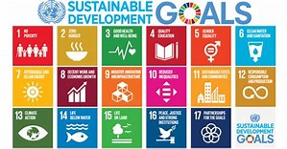
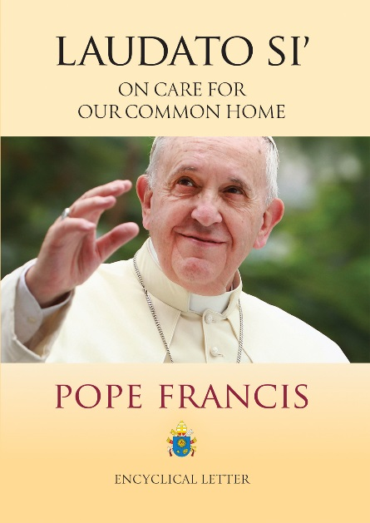
Extension Task
“The poor are hurt the most by climate change”
Pope Francis
How does this statement make you feel?
In what ways do you think climate change hurts the poor the most?
Is there any thing unjust, unfair or wrong about this situation?
What do you think is wrong here?
Answer :Many of the poor live in areas particularly affected by phenomena related to warming, and their means of subsistence are largely dependent on natural reserves and ecosystemic services such as agriculture, fishing and forestry. They have no other financial activities or resources which can enable them to adapt to climate change or to face natural disasters, and their access to social services and protection is very limited. […]
There has been a tragic rise in the number of migrants seeking to flee from the growing poverty caused by environmental degradation. They are not recognized by international conventions as refugees; they bear the loss of the lives they have left behind, without enjoying any legal protection whatsoever. Sadly, there is widespread indifference to such suffering, which is even now taking place throughout our world. (25)

Slide 5
Spring Term
Week commencing 6th January 2020.
Australian Fires.

Slide 6
How does this news event/situation
make you feel?
Do you see kindness , equality and justice here?
What do you think is good here?
Is there any thing unjust, unfair or wrong about this situation?
What do you think is wrong here?
What positive qualities and values should this situation arouse in us as people who care about the needs of others?
Empathy? Mercy? Compassion? Kindness?
Love? Accountability? Forgiveness?
Hope?
Faith?
https://www.youtube.com/watch?v=5PTwWcAXd9Q
https://t.co/9TAu6P9epS

Slide 7
^{Australian Bush Fires}
Scripture. What does God say? | Prayer
“The land must not be sold permanently , because the land is mine and you are but ….my tenants.” Leviticus 25 :23-24 We have a responsibility to look after our environment, we don’t own the world, we are caretakers of it for future generations. Suppose a brother or sister is without clothes and daily food. If one of you says to him, “Go, I wish you well ; keep warm and well fed, but does nothing about his physical needs , what good is it? In the same way, faith by itself, if it is not accompanied by action, is dead.” James 2 14-17 We have a responsibility to act with love, charity and care for those in need. Saying we care is not enough, we must put our words into action.
God our prayers today are with those communities and individuals whose lives have been damaged in differing ways by the bushfires.
We pray for all those who have been affected; for the families and friends of those who have been killed.
We pray for those who are missing, for their safety, for the fears of those who love them; bring each one home safe, we pray.
We pray, too, knowing that we are entering a harsher climate, less predictable and more volatile; as we care for each other, help us to care for your creation, to be worthy stewards and advocates of all which you have made.
Amen
Putting your faith into ACTION.
https://t.co/9TAu6P9epS

Slide 8
Extension task
“God always forgives, we men forgive sometimes, but nature never forgives. If you give her a slap, she will give you one. I believe we have exploited nature too much.”
Pope Francis 2015
Although the Australian fires seem very distant from us, how should they influence and increase our awareness of local environmental responsibilities?
How should the events in Australia influence the way we act towards each other here in our local community?

